Slide 1
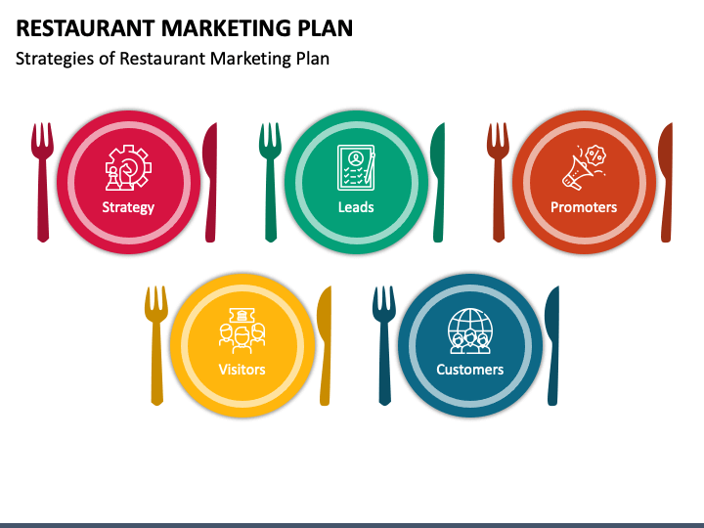

RESTAURANT ORDER ANALYSIS
PRESENTED BY: ABHISHEK SUNEJA
SOURCE - MAVEN ANALYTICS

Slide 2

SITUATION
“The taste of the world café” debuted a new menu at the start of the year. As a data analyst, we’ve been asked to dig deeper into the data provided for the customers to generate various insights to enhance business growth.
OBJECIVE
Explore the two tables ‘Dim.Order_details’ & ‘Fact.menu_items’ and extract key trends for particular menu items, customer feedback for new items, customer preference for items etc.

Slide 3
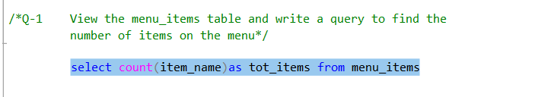

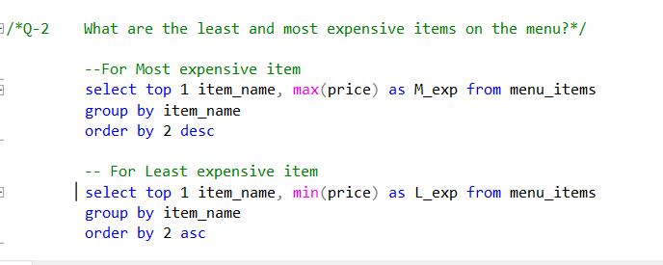


PROBLEM STATEMENT
SOLUTION
MOST_EXP
LEAST_EXP

Slide 4
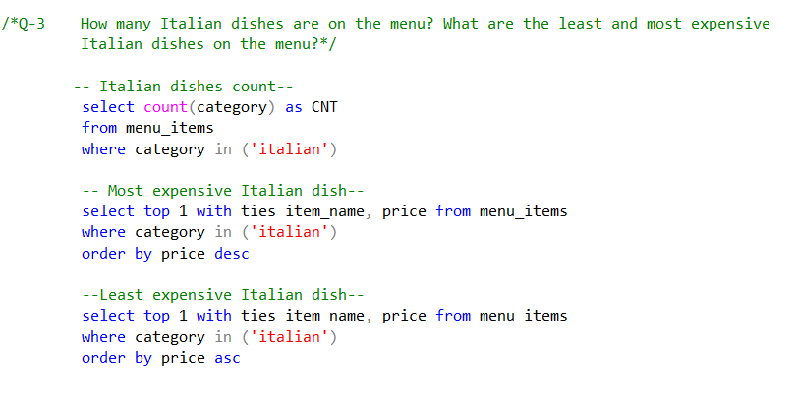



PROBLEM STATEMENT
SOLUTION
DISH COUNT
MOST_EXP_ITALIAN
LEAST_EXP_ITALIAN

Slide 5
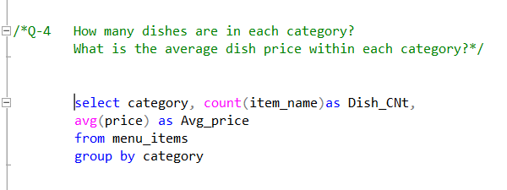
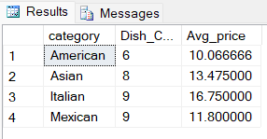
PROBLEM STATEMENT
SOLUTION

Slide 6
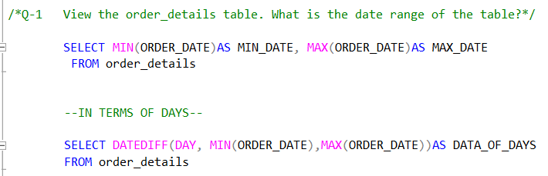


PROBLEM STATEMENT
SOLUTION
START – END DATE
NO OF DAYS

Slide 7
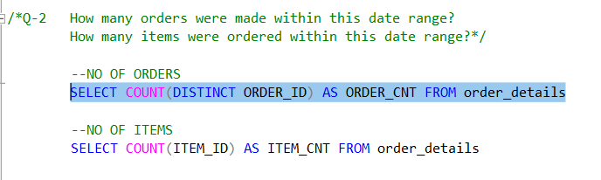


PROBLEM STATEMENT
SOLUTION
ORDER COUNT
ITEM COUNT

Slide 8
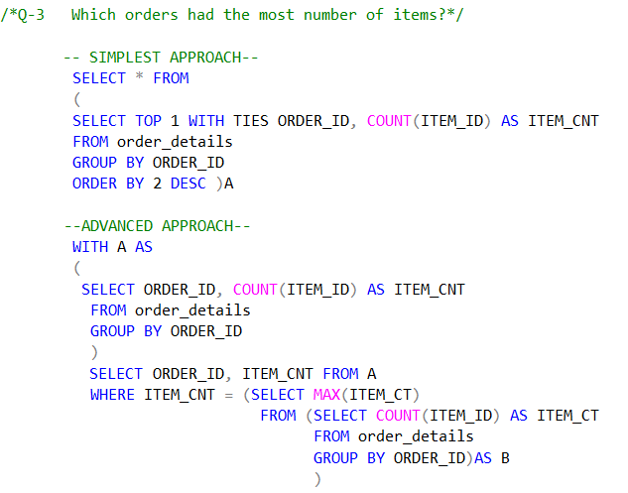
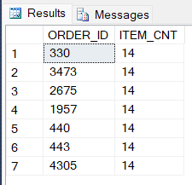
PROBLEM STATEMENT
SOLUTION

Slide 9
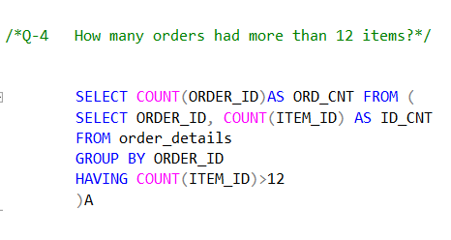

PROBLEM STATEMENT
SOLUTION

Slide 10
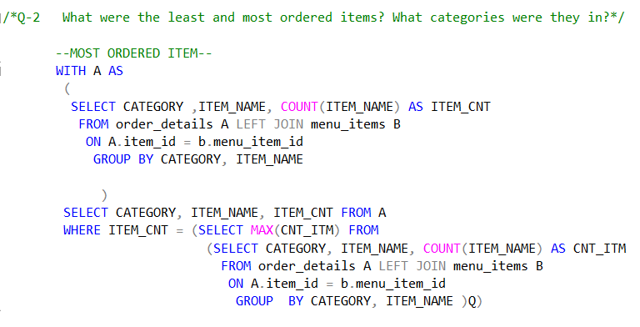

PROBLEM STATEMENT
SOLUTION

Slide 11
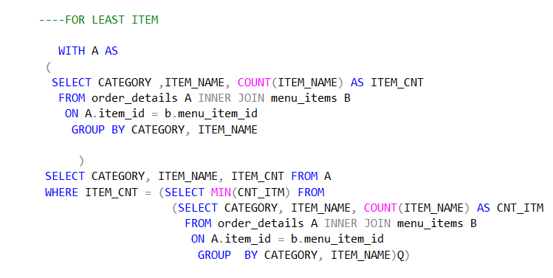

PROBLEM STATEMENT
SOLUTION

Slide 12
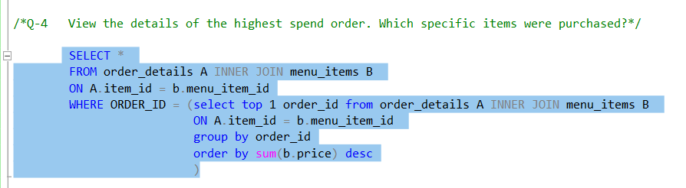
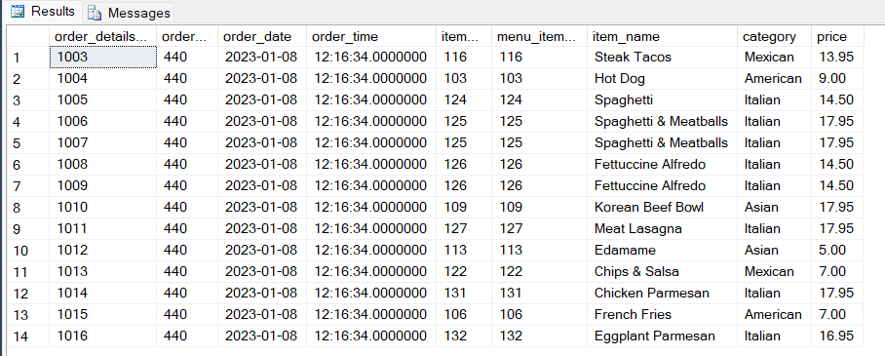
PROBLEM STATEMENT
SOLUTION

Slide 13
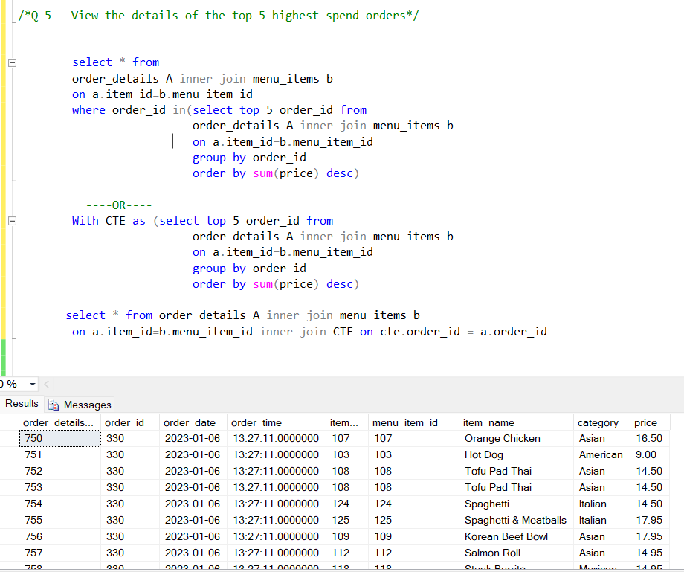
PROBLEM STATEMENT
SOLUTION

Slide 14
THANK YOU

